Slide 1
Installing and Upgrading Custom Solutions

Slide 2
Agenda
Solution Deployment Options
Feature/Solution Dependencies
Resource Files
Solution Upgrading

Slide 3
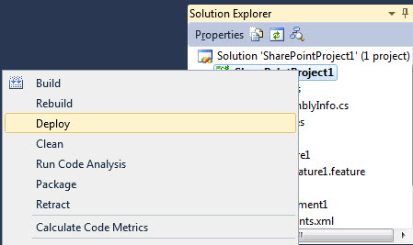
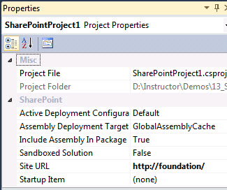
Visual Studio Solution Deployment

Slide 4
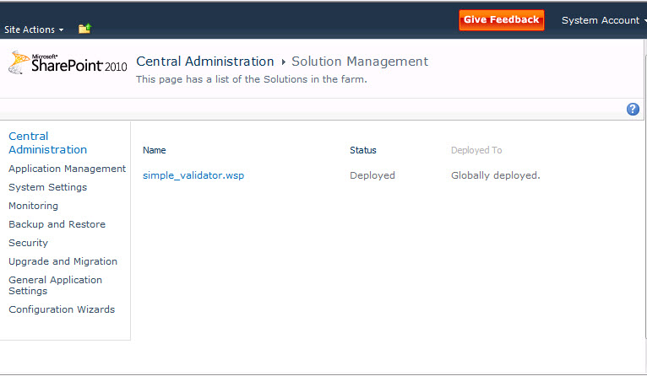
Farm Solution Deployment

Slide 5
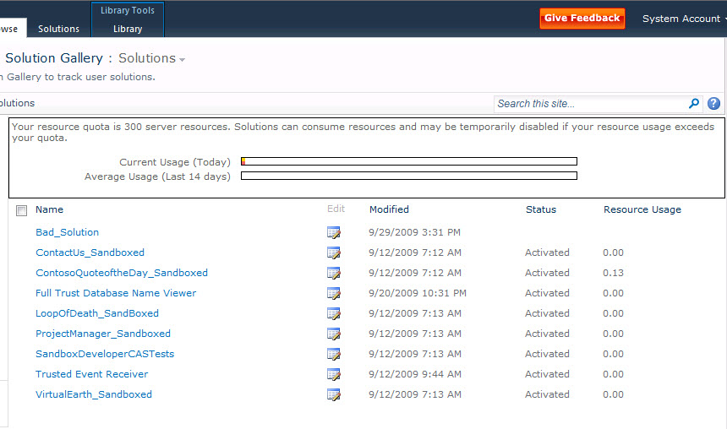
Sandboxed Solution Deployment

Slide 6
PowerShell Deployment
Add-SPSolution
-LiteralPath "c:\...\SharePointProject1.wsp"
Install-SPSolution
-Identity "SharePointProject1.wsp" –GACDeployment
Enable-SPFeature
-Identity "SharePointProject1_Feature1\Feature.xml“
-Url "http://contoso"
Uninstall-SPSolution
-Identity "SharePointProject1.wsp“
Remove-SPSolution
-Identity "SharePointProject1.wsp"
Update-SPSolution

Slide 7
Solution Deployment
demo
Notes:
This is a simple demo designed to show deployment in different ways
Make a new VS2010 project, select to deploy to the Farm
Then change the “Sandboxed Solution” property and deploy to the site collection
Then take the WSP and run a PS script to deploy it

Slide 8
Feature Dependencies
Available in SharePoint 2007
Created in Feature.xml
Activates and Deactivates Features in the same scope
Supports cross-scope activation under certain conditions
<Feature Id=" " Title=" " Scope="Site">
<ActivationDependencies>
<ActivationDependency FeatureId=" " />
</ActivationDependencies>
<ElementManifests>
<ElementManifest Location="Elements.xml"/>
</ElementManifests>
</Feature>

Slide 9
Solution Dependencies
Solution Dependency (New in SharePoint 2010)
Created in manifest.xml
Ensures a dependent solution is avalable and deployed
Does not deploy dependent solutions
Dependency check at deployment time
No VS2010 Designer support, edit manually
<Solution SolutionId=" " …>
<ActivationDependencies>
<ActivationDependency SolutionId=" " />
</ActivationDependencies>
...
</Feature>

Slide 10
Resource Files
Add an Empty Element to the Feature
Add a Resource File to the Element
Select Deployment Type
AppGlobalResource = App_GlobalResources
ApplicationResource = Resources
AppGlobalResource is available to every page
ApplicationResource just deploys to a private folder and has limited value so it’s being replaced.
<asp:Button ID="Button1" runat="server"
Text="<%$ Resources:WebResources, Button1Caption %>" />
Notes:
The resource expression takes the following form, where Class is optional, unless the resource is a global one, and ResourceID is required:
<%$Resources:Class,ResourceID%>
The Class value identifies the resource file to use when you use global resources. When .resx files are compiled, the base file name, without extensions, is used as the class name of the resulting assembly, explicitly. If you want to use resources from a local resource file (one that matches the current page name), you do not have to include a class name. This is because ASP.NET matches the page class to the resource class.
The ResourceID value is the identifier of the resource to read. In the previous example, the Text property for the button is read from the global resource file WebResources.resx (or the appropriate localized version). In that file, ASP.NET uses the value for the resource with the identifier Button1Caption and for the page itself. To set page properties, you can use resource expressions in the @ Page directive.

Slide 11
Solution Upgrades
Upgrade occurs on activation
Assembly Versioning
BindingRedirect entries in manifest.xml
Declarative & Programmatic Upgrade Actions
Take action when upgrading
Feature Upgrade Query Object Model
Find out what features are installed and what their versions are.

Slide 12
Assembly Versioning
<Solution SolutionId="FFFA1B1B-AAA4-AA35-1234-AAAA7FE1DEAA“
xmlns="http://schemas.microsoft.com/sharepoint/">
<FeatureManifests>
<FeatureManifest Location="TestWebParts\feature.xml"/>
</FeatureManifests>
<Assemblies>
<Assembly DeploymentTarget="GlobalAssemblyCache“
Location="MyWebPart.dll">
<BindingRedirects>
<BindingRedirect OldVersion="1.0.0.0" />
</BindingRedirects>
<SafeControls>
...
</SafeControls>
</Assembly>
</Assemblies>
</Solution>
Notes:
BindingRedirect allows redirecting old versions of installed assemblies to new versions.
Example of what is added to web.config
<dependentAssembly>
<assemblyIdentity name=“asmname” publicKeyToken=“key” culture=“neutral”>
<bindingRedirect oldVersion=“1.0.0.0” newVersion=“2.0.0.0” />
</dependentAssembly>

Slide 13
Declarative Upgrade Actions
<Feature>
<UpgradeActions>
<VersionRange BeginVersion="1.0.0.0" EndVersion="2.0.0.0">
<AddContentTypeField ContentTypeId="“
FieldId="" PushDown="True"/>
<MapFile FromPath="OldPath\MyPage.aspx“
ToPath=“NewPath\MyPage2.aspx"/>
<ApplyElementManifests>
<ElementManifest Location ="Custom\Elements.xml"/>
</ApplyElementManifests>
<CustomUpgradeAction Name ="MyCustomAction">
<Parameters>
<Parameter Name="arg1">MyText</Parameter>
</Parameters>
</CustomUpgradeAction>
</VersionRange>
</UpgradeActions>
</Feature>
Notes:
AddContentTypeField adds a new column to a content type
MapFile changes the mapping for paths in the content database
ApplyElementManifests uses the new elements file
CustomUpgradeAction is accessible from the Upgrade event handler

Slide 14
Programmatic Upgrade Event
public override void FeatureUpgrading(
SPFeatureReceiverProperties properties,
string upgradeActionName,
IDictionary<string, string> parameters) {
if (upgradeActionName.Equals("MyCustomAction“)) {
string myval= parameters[“arg1"];
}
}

Slide 15
Solution Upgrade
demo
Notes:
This is a demo of the solution upgrade
There are two WSP files and two PS scripts for the demo

Slide 16
Feature Querying
QueryFeatures() method (4 overloads)
(Guid featureId)
(Guid featureId, bool needsUpgrade)
(Guid featureId, Version featureVersion)
(SPFeatureScope, bool needsUpgrade)
Available from SPWebService, SPWebApplication, SPContentDatabase and SPSite
Notes:
Returns SPFeatureQueryResultCollection
Depending on at what level you query the returned features could cover various scopes
SPWebService
Finds all instances of the feature with given id that require upgrade in the farm. All scopes of features (Farm, Web Application, Site collection, Web) are supported.
SPWebApplication
Finds all instances of the feature with given id in all content databases. Web app/site collection/web scoped features are supported.
SPContentDatabase
Overloads of QueryFeatures function of this class find site and web scoped features in content database that conform to filtering criteria. Returned collection is ordered with regard to web hierarchy. Parent web features goes before child web features and traversal of the tree is done in depth-first manner.
SPSite
Overloads of QueryFeatures function of this class find web scoped features in site collection that conform to filtering criteria. Returned collection is ordered with regard to web hierarchy. Parent web features goes before child web features and traversal of the tree is done in depth-first manner. Overloads of QueryFeatures function of this class will be available in Client OM.

Slide 17
Feature Querying
demo

Slide 18
Summary
Solution Deployment Options
Feature/Solution Dependencies
Resource Files
Solution Upgrading

